Slide 1



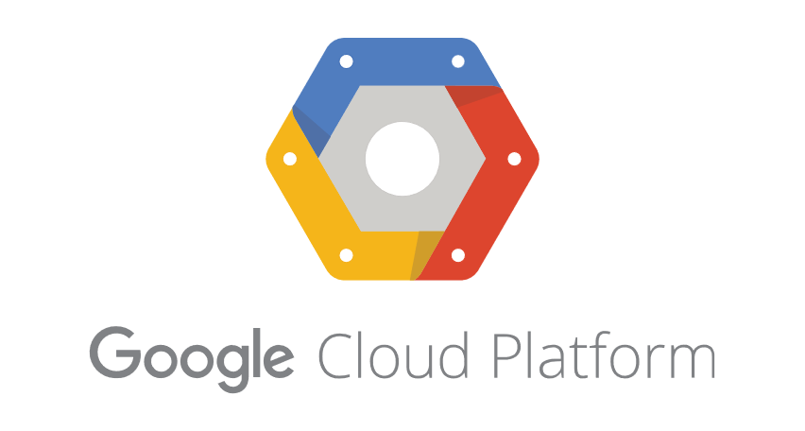


Catching Bad Guys In the Clouds Using What Your Mama Gave You and a Little Help From Your Friends Wes Lambert, BlueTeam Con Webinar 2020

Slide 2
Agenda
Cloud Data
Cloud Monitoring
Native Resources
what Mama|Daddy|<insert parental figure here> gave us
Open Source Tools
a little help from our friends to make things even better

Slide 3
Cloud Data: Storage/Transit
Amazon Web Services
S3 Buckets
Dynamo DB
Azure
Blobs
Event Hubs
Google Cloud Platform
Storage Buckets
Cloud Datastore/Filestore
Application/Network Traffic

Slide 4
Cloud Data: Exploited/Abused
AWS (Amazon Web Services)
S3Scanner
scan for open S3 buckets
AWSBucketDump
enumerate buckets and look for interesting files
https://github.com/sa7mon/S3Scanner
https://github.com/jordanpotti/AWSBucketDump

Slide 5
Cloud Data: Exploited/Abused
Azure
MicroBurst
Azure Services discovery
weak configuration auditing
post exploitation actions
https://github.com/NetSPI/MicroBurst

Slide 6
Cloud Data: Exploited/Abused
GCP (Google Cloud Platform)
GCPBucketBrute
enumerate Google Storage buckets
determine access level
check for privesc
https://github.com/RhinoSecurityLabs/GCPBucketBrute

Slide 7
Cloud Credentials (AWS)
Account passwords phished via email
IAM account credentials
Root account credentials
Access keys
Control AWS servers without user/pass
Obtained via phish or some other method

Slide 8
Cloud Credentials (AWS)
Privilege Escalation
Creating new policy versions
Creating new user access keys
Adding malicious Lambda layer to existing function
https://github.com/RhinoSecurityLabs/AWS-IAM-Privilege-Escalation

Slide 9
Cloud Data: Lack of Monitoring
Problem:
Attackers take full advantage of misconfigured and poorly monitored cloud instances/deployments
No visibility into the interaction and access of cloud instances and data, and no way to detect abuse, unless otherwise monitored/reported

Slide 10
Cloud Data: Lack of Monitoring
Ideal Solution:
To the extent possible, we should monitor the cloud just as we do our local environments

Slide 11
Cloud Data: Lack of Monitoring
BUT…
Practitioners may not be aware of mechanisms available for monitoring activity in the cloud
For many, it’s not easy to capture, aggregate and present this data for consumption

Slide 12
Cloud Monitoring: Let’s Solve the Problem
What applications/resources do we have in the cloud?
How can we increase visibility?
Where to start monitoring with native capabilities?
How can we augment native monitoring with other tools in a cost-effective fashion?

Slide 14
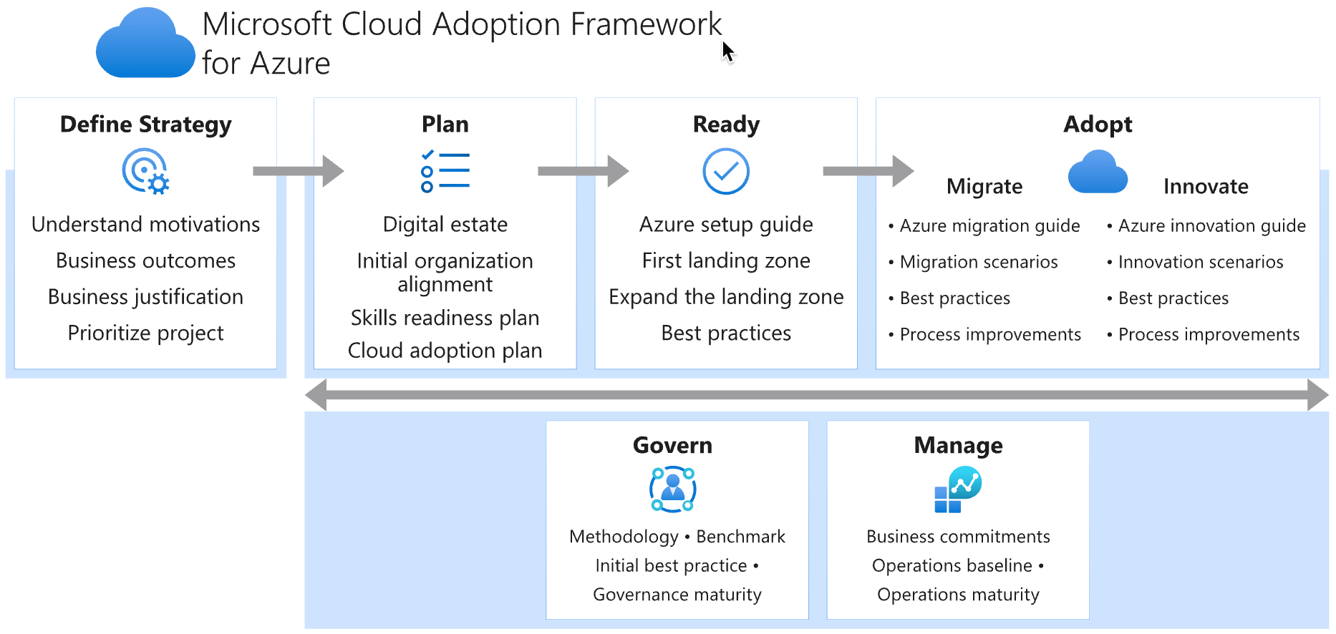
Cloud Adoption Framework for Azure
Framework for adoption of the cloud
Starting point for orgs to safely and
securely build, monitor, and manage cloud deployments
https://docs.microsoft.com/en-us/azure/cloud-adoption-framework/manage/monitor/

Slide 15
Azure Platform Logging
Resource Logs – operations performed within a resource (data plane)
Database request
Activity Log – operations performed on a resource from management perspective (management plane)
Who, What, When
Azure AD Logs – history of login, audit trail of changes with regard to Azure AD
NSG Flow Logs (Azure Network Watcher) – log network flows
https://docs.microsoft.com/en-us/azure/azure-monitor/platform/platform-logs-overview
https://docs.microsoft.com/en-us/azure/network-watcher/network-watcher-nsg-flow-logging-overview

Slide 16
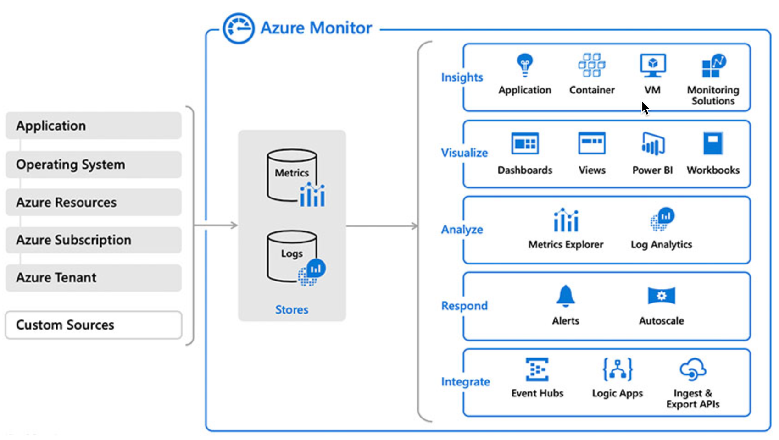
Azure Monitor
Gather data to monitor:
Applications
Infrastructure
Network
https://azure.microsoft.com/en-us/services/monitor

Slide 17
Event Hubs
Security Center Alerts
Activity Log
Big data streaming platform
Centralize event collection for export to other services
Integrate with external services for postprocessing, alerting, etc.
Azure AD Logs
Azure
Event Hubs
Resource Logs
NSG Flow Logs
https://docs.microsoft.com/en-us/azure/security/fundamentals/log-audit

Slide 18
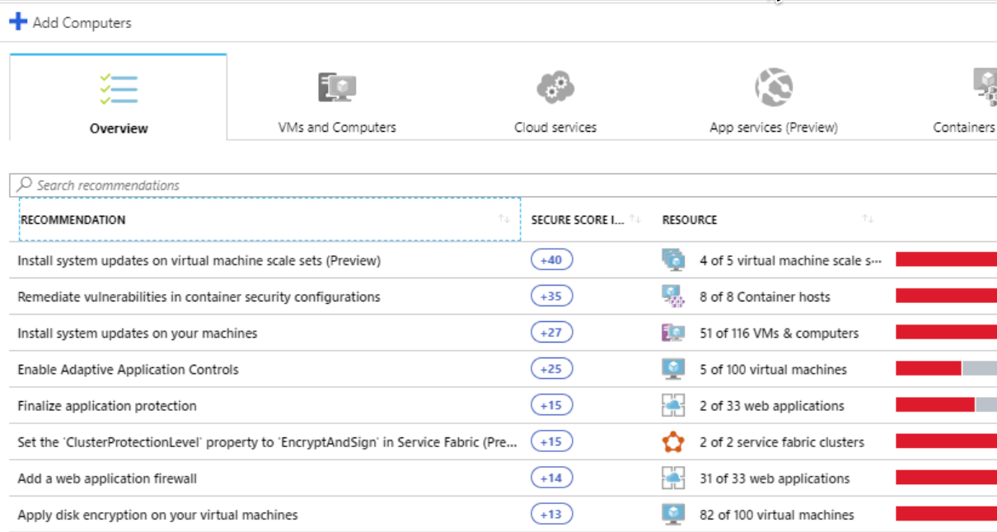
Azure Security Center
Free and standard tier
Supports hybrid cloud
Manage organization policy and compliance
Continuous assessment of resource security
Recommendation of controls
Threat protection includes kill-chain analysis
https://azure.microsoft.com/en-us/services/security-center/

Slide 19
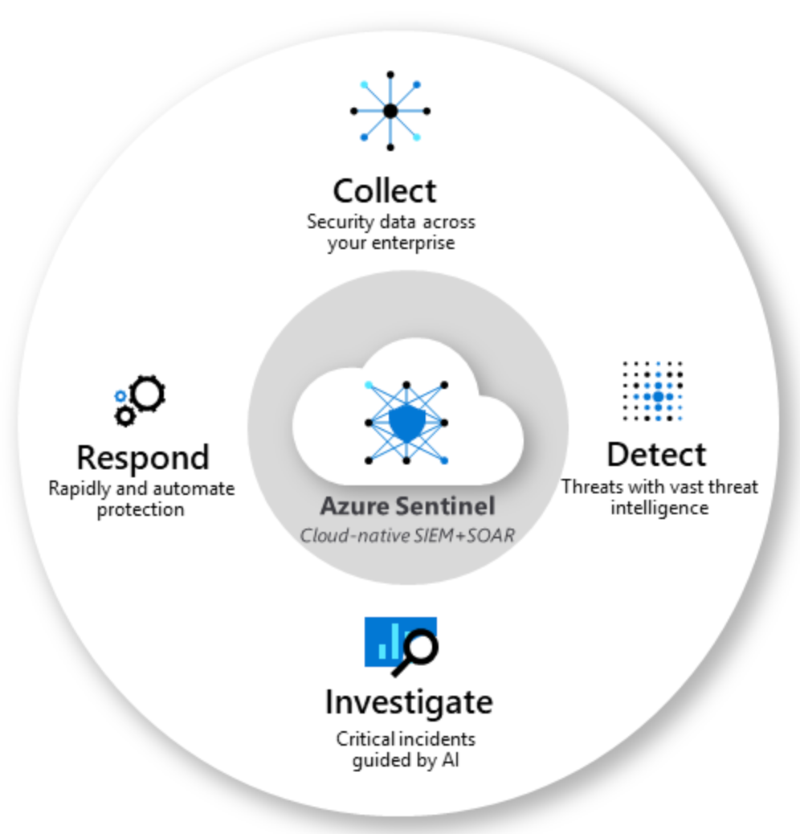
Azure Sentinel
Cloud-native SIEM
SOAR
Analytics
Investigation
Hunting
Sigma support (SOC Prime TDM)
Can be expensive when ingesting many different data sources $$$
https://azure.microsoft.com/en-us/services/azure-sentinel/#features

Slide 20
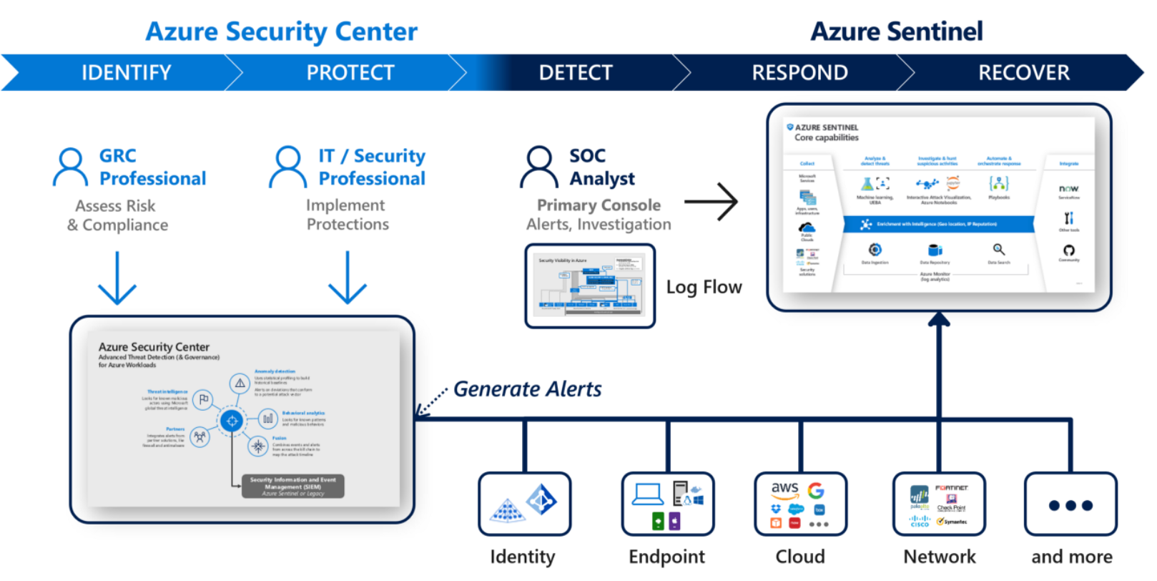
Comparing ASC & Azure Sentinel
https://medium.com/the-cloud-builders-guild/what-is-the-difference-between-azure-security-center-and-azure-sentinel-9d91eb801cd2

Slide 22
GCP Logging
Cloud Logging (formerly Stackdriver)
Firewall Logging – effects of FW rules
VPC Flow Logs – sample of network flows
Access Transparency Logs – actions taken by Google personnel

Slide 23
GCP Logging (Continued)
Audit Logs
Admin Activity – API calls or admin actions that modify config/metadata
Data Access – API calls that read resource config/metadata, as well as create/modify/read resource data
NOTE: Data-access operations on resources that are publicly shared/do not require a GCP login, are NOT recorded
System Event – Google Cloud admin actions; generated by Google Cloud, and not user action

Slide 24
GCP Monitoring and Alerting
AWS Monitoring – allow organizations to monitor hybrid cloud environments
Alerting – alert on data from Cloud logging or monitoring metrics
Packet Mirroring
Allows for capture of the complete conversation between hosts on the network
Extremely valuable for network forensics and security monitoring, and can be relatively inexpensive to implement compared to some other methods

Slide 25


Slide 26
AWS Logging and Monitoring: Cloudwatch
Cloudwatch
Monitor applications in AWS and in on-premises environments
Assist with resource optimization
Alert/trigger actions on log metrics/conditions
https://aws.amazon.com/cloudwatch/

Slide 27
AWS Logging and Monitoring: Cloudtrail
Cloudtrail
Audit events with regard to AWS account activity
Assist with cloud governance, compliance
Automate response with CloudWatch Events

Slide 28
AWS Logging and Monitoring: Cloudtrail Events
ConsoleLogin
StopLogging
CreateNetworkAclEntry, CreateRoute
AuthorizeSecurityGroupEgress, AuthorizeSecurityGroupIngress, RevokeSecurityGroupEgress, RevokeSecurityGroupIngress
ApplySecurityGroupsToLoadBalancer, SetSecurityGroups

Slide 29
AWS Logging and Monitoring: VPC Mirroring
VPC Mirroring
Similar to Packet Mirroring in GCP
Assist with compliance, security monitoring, threat detection
https://docs.aws.amazon.com/vpc/latest/mirroring/what-is-traffic-mirroring.html
https://docs.aws.amazon.com/vpc/latest/mirroring/traffic-mirroring-considerations.html

Slide 30
AWS GuardDuty
Threat detection
Continuous monitoring
Analysis/correlation between Cloudtrail, VPC Flow, and DNS logs
Like Sentinel, can be expensive $$$, depending on the amount of data/usage, and compared to other options
Sometimes makes it difficult for smaller organizations to adopt/utilize

Slide 31
We’ve been given some great native resources, but how can we leverage a little help from our friends?

Slide 32
Enter the onion…

Slide 33
Security Onion: Introduction
Created by Doug Burks in 2008
Free and open source platform for intrusion detection, enterprise security monitoring, and log management
Can be installed from an ISO image or packages on top of Ubuntu 16.04 in minutes
Traditionally fed data from a TAP or SPAN port
Integrated with the Elastic Stack for data enrichment, indexing, and visualization

Slide 34
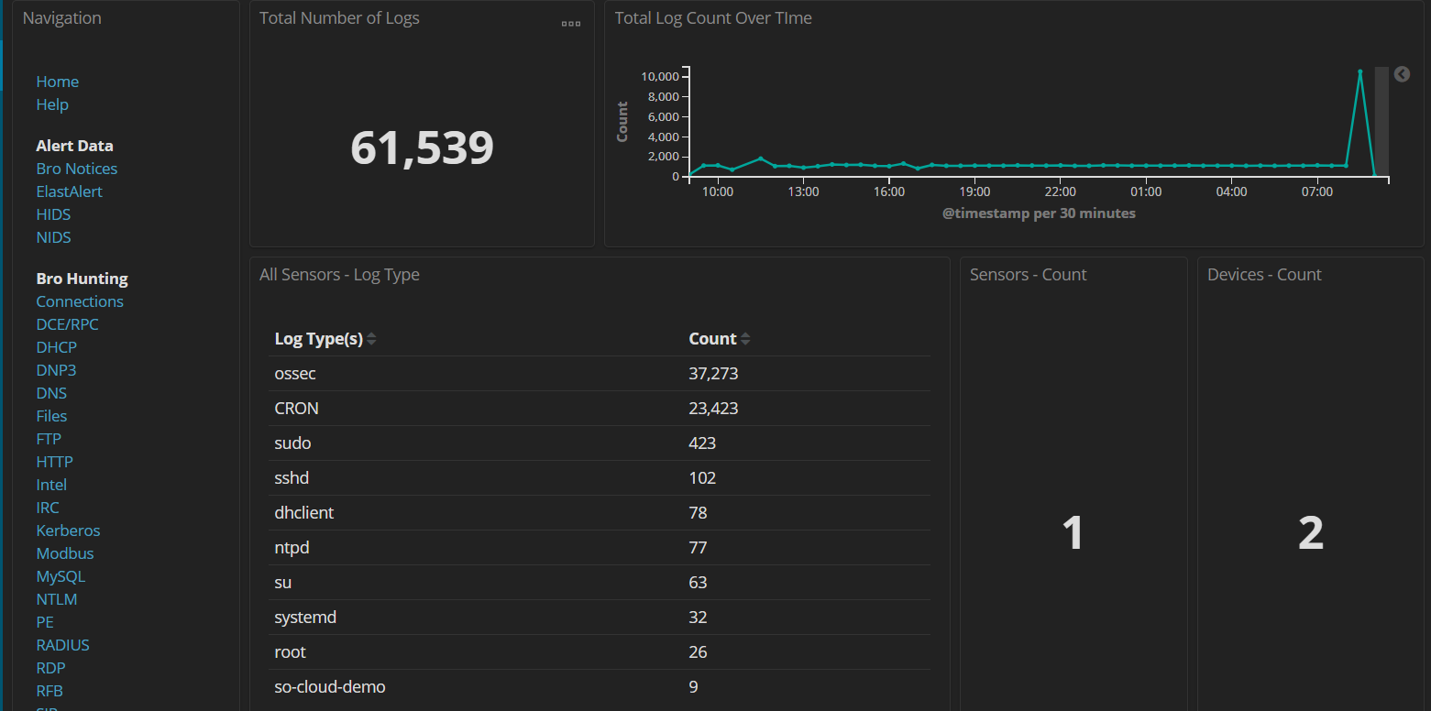
Security Onion: Introduction

Slide 35
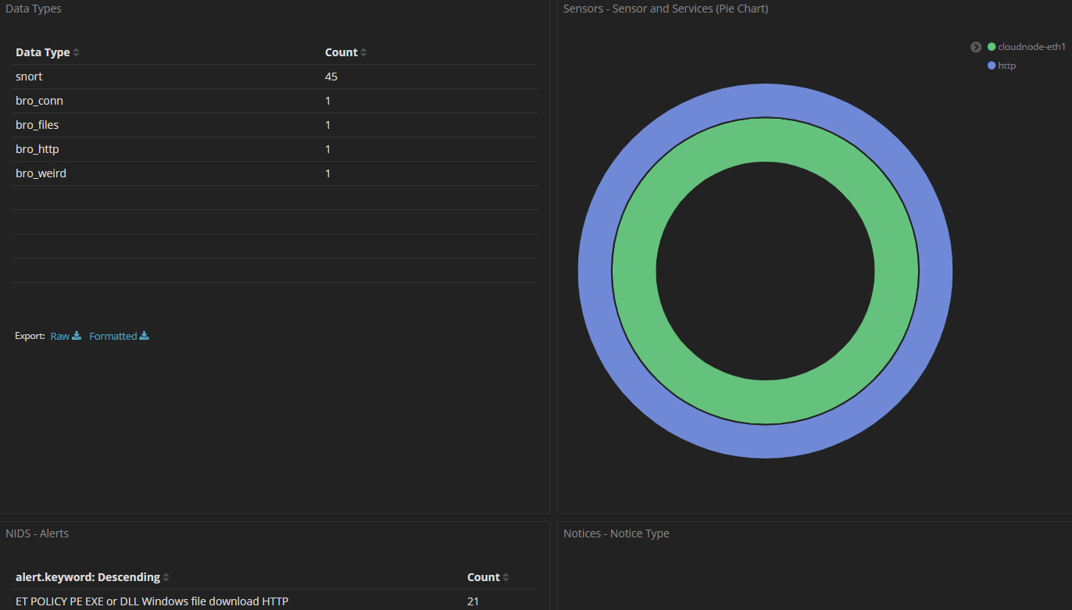

Slide 36
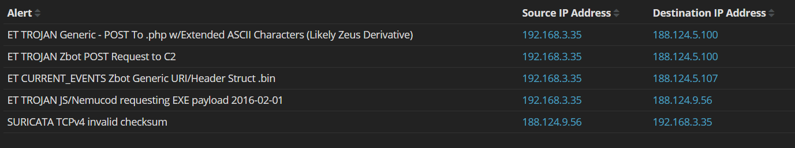
Security Onion: Alert Data
HIDS/NIDS Alerts
Wazuh/Snort/Suricata

Slide 37
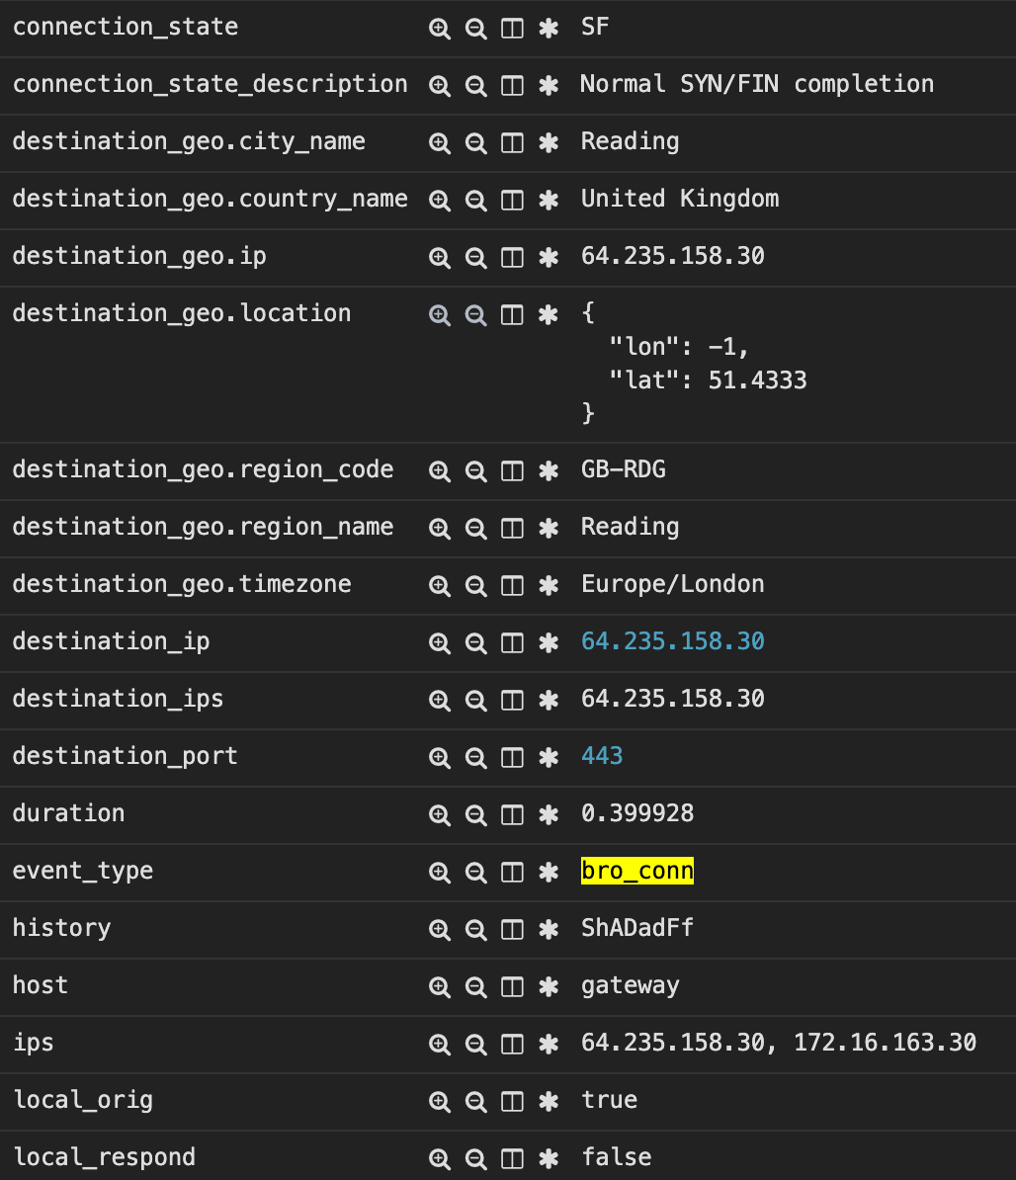
Security Onion: Metadata
Network Metadata
Bro/Zeek
DNS
HTTP
SIP
SSL
and much more

Slide 38
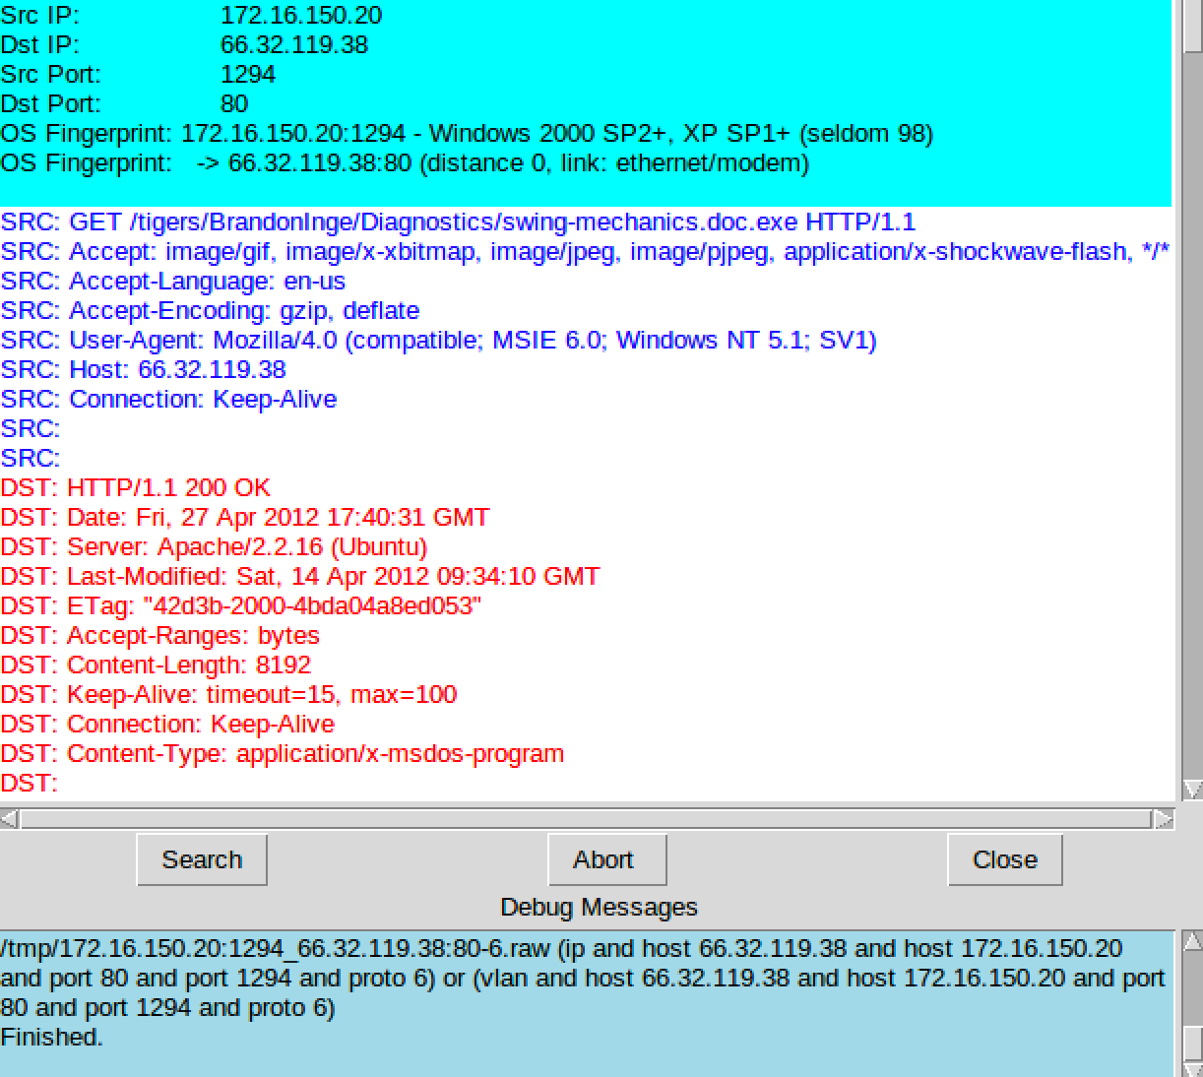
Security Onion: Full Content Data
Full Content Data (PCAP)
Netsniff-NG
Complete transcript

Slide 39
Security Onion: Supplementary Data
Elastic Beats
Filebeat – Application Logs, Cloud logs
Winlogbeat – Windows Event Logs
Packetbeat – Network traffic
Logstash input plugins
S3
Azure Event Hubs
Syslog

Slide 40
That’s great and all, but how can we use Security Onion to monitor the cloud?

Slide 41
Security Onion: Azure Data
Security Center Alerts
Activity Log
Security Onion
Azure AD Logs
Event Hubs
Logstash
Resource Logs
NSG Flow Logs

Slide 42
Security Onion: Azure Configuration
Create a resource group
Create an Event Hubs namespace
Create an event hub
Stream logs to the event hub
Use the Logstash azure_event_hubs input plugin to ingest data into Security Onion
https://docs.microsoft.com/en-us/azure/event-hubs/event-hubs-create
https://docs.microsoft.com/en-us/azure/active-directory/reports-monitoring/tutorial-azure-monitor-stream-logs-to-event-hub
https://www.elastic.co/guide/en/logstash/current/plugins-inputs-azure_event_hubs.html

Slide 43
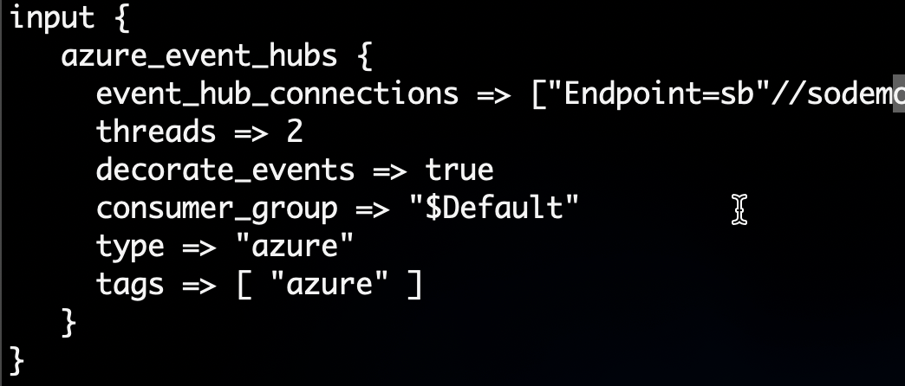
Security Onion: Azure Configuration

Slide 44
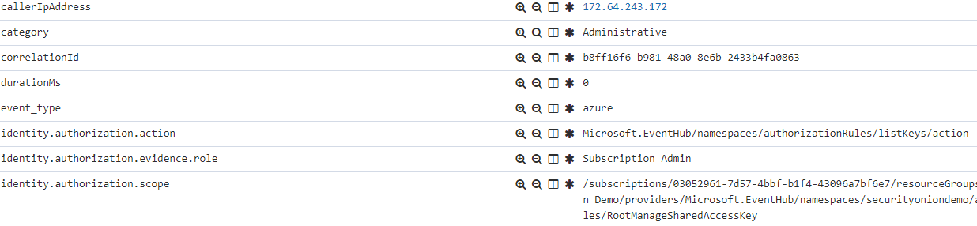
Security Onion: Azure Data

Slide 45
Security Onion: Google Cloud Data
Audit Logs
Cloud Logging
Pubsubbeat
Export (Sink)
Subscription
VPC Flow Logs
Security Onion
Logstash

Slide 46
Security Onion: GCP Configuration
Create filter in Cloud Logging and export logs pub/sub via sink
Subscribe to the topic by creating a subscription
Obtain IAM service credentials
Install/configure pubsubbeat to pull from GCP
https://logz.io/blog/google-pub-sub/
https://github.com/GoogleCloudPlatform/pubsubbeat/

Slide 47
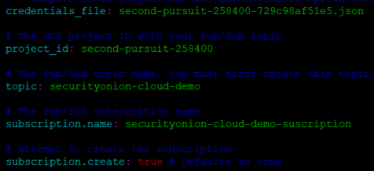
Security Onion: pubsubbeat.yml

Slide 48
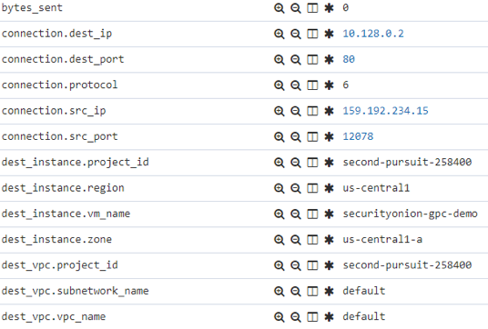
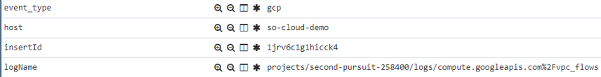
Security Onion: GCP Data

Slide 49
Security Onion: AWS
Cloudtrail
Security Onion
S3
Logstash
Cloudwatch

Slide 50
Security Onion: AWS Cloudwatch
Configure Cloudwatch to watch for events and send to S3 bucket
Logstash pulls from S3 bucket and processes into Elastic Stack on Security Onion
Hunt through data in Kibana and/or alert internally/centrally using Elastalert via Security Onion
https://docs.aws.amazon.com/AmazonCloudWatch/latest/logs/S3Export.html
https://www.elastic.co/guide/en/logstash/current/plugins-inputs-s3.html

Slide 51
Security Onion: AWS VPC Mirroring
Mirror Session
Mirror Source
(ENI)
Mirror Source
(ENI)
Mirror Target
(Security Onion/ENI)
Mirror Filter
Mirror Source
(ENI)

Slide 52
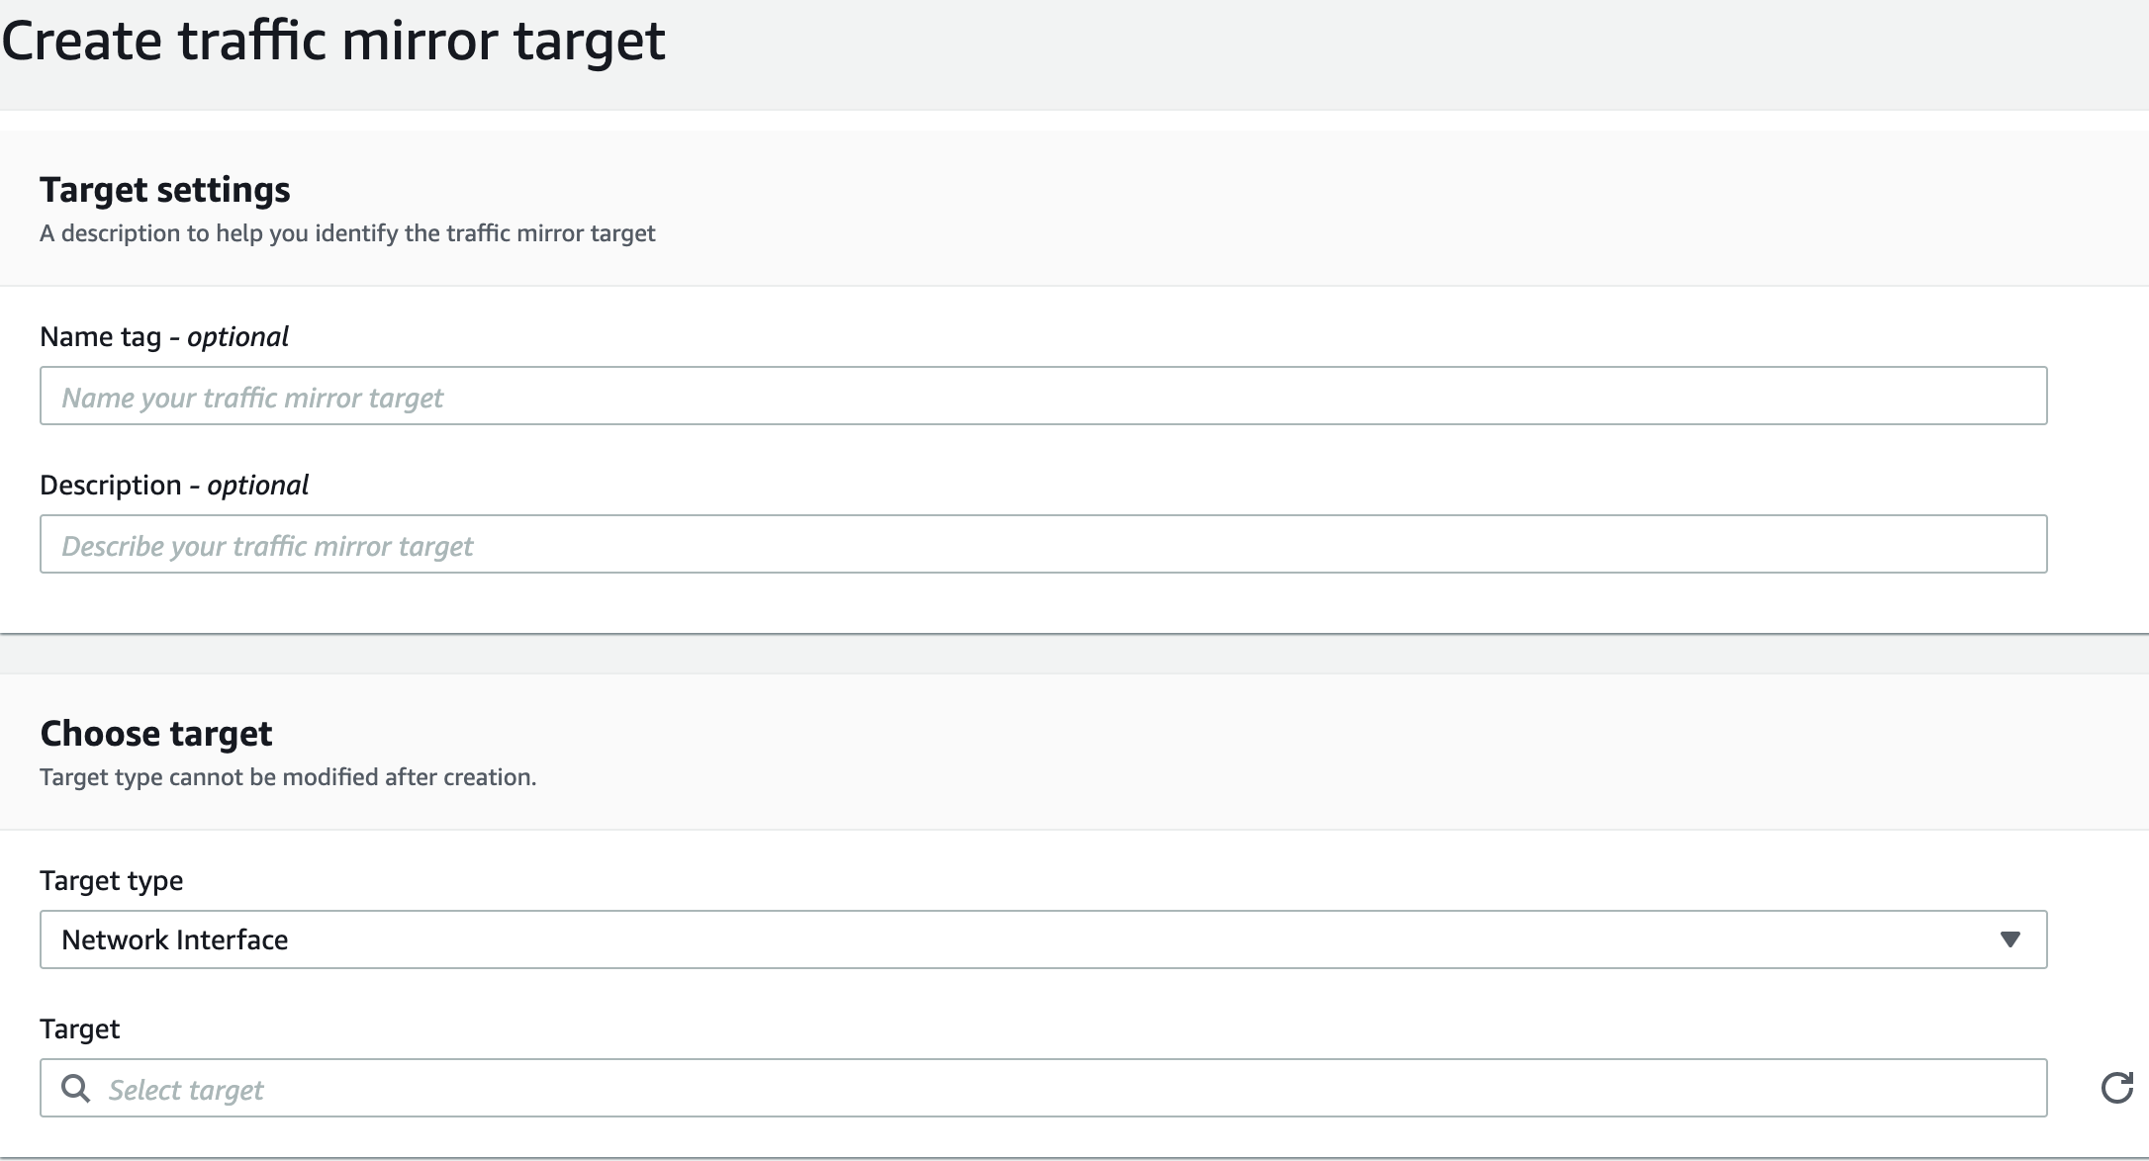
VPC Mirror Target
Define the target interface where we would like to send mirrored traffic

Slide 53
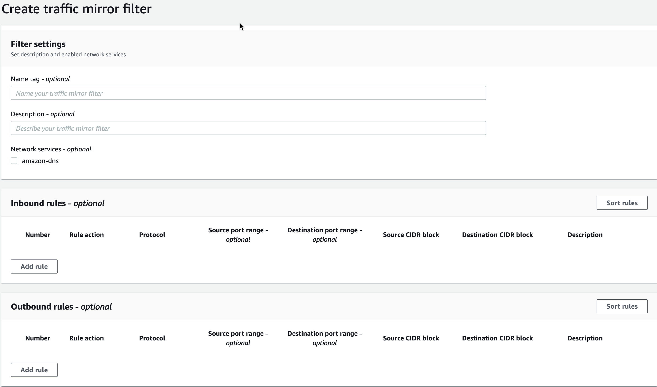
VPC Mirror Filter
Define the protocols/traffic to be mirrored
Filter out any unwanted traffic

Slide 54
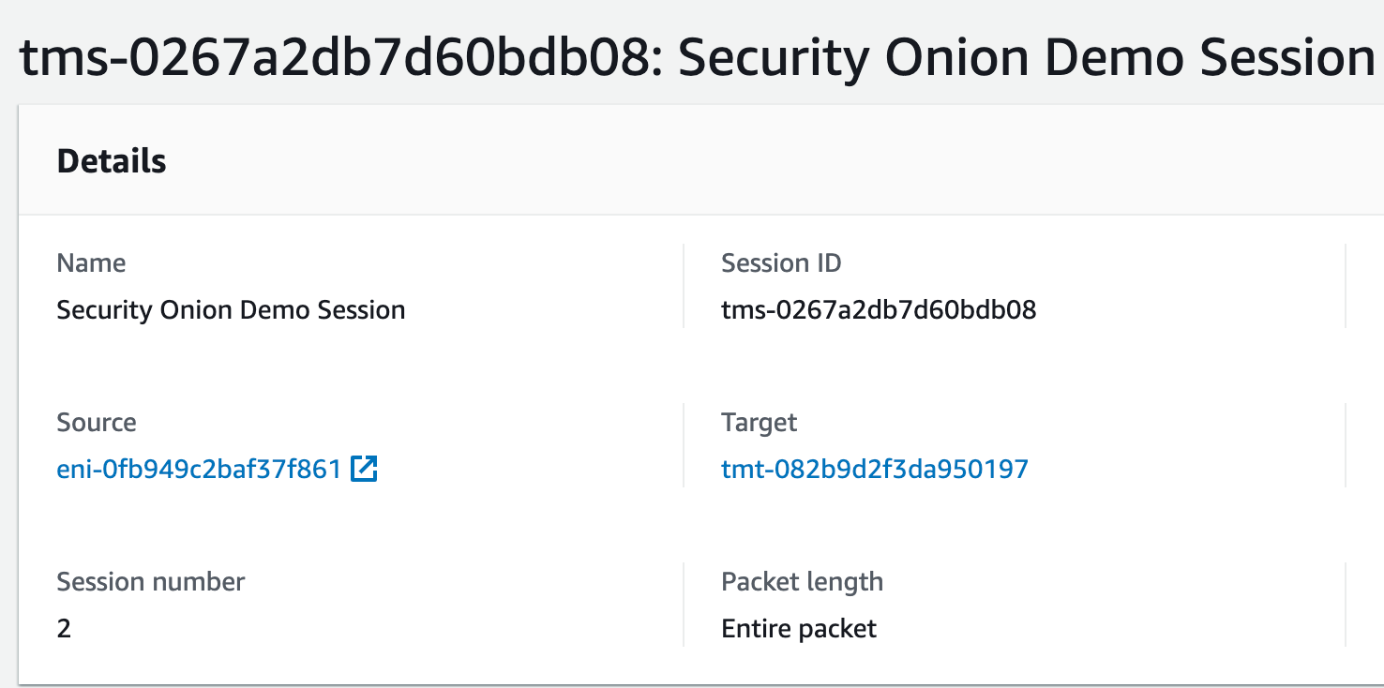
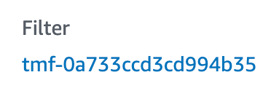
VPC Mirror Session
Mirror Session is comprised of:
Source interface (to be mirrored)
Target Interface
Mirror Filter

Slide 55
Security Onion: AWS Cloud Node
On-prem
Forward Node
Master Server
Forward Node
(AWS)
Storage Node

Slide 56
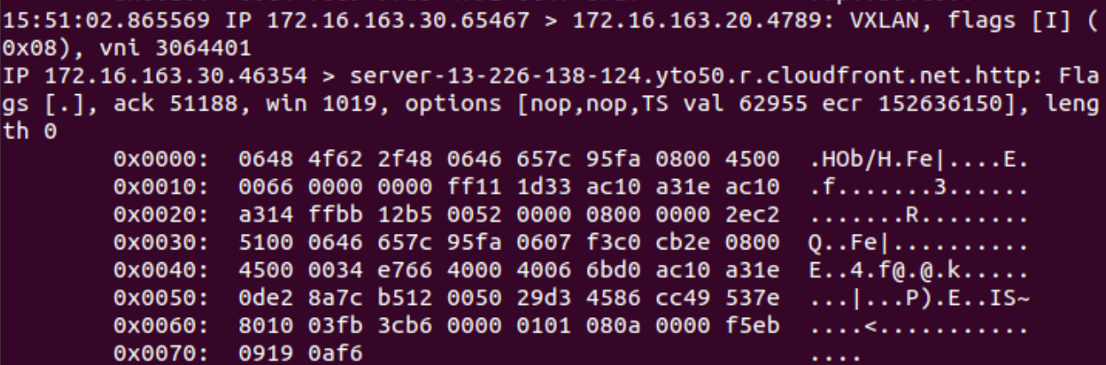
Security Onion: AWS Cloud Node

Slide 57
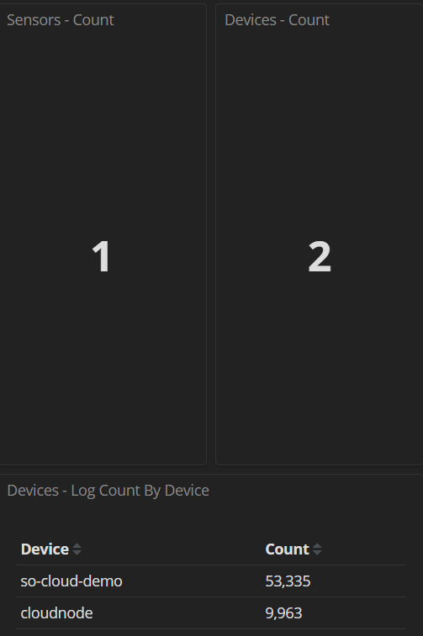
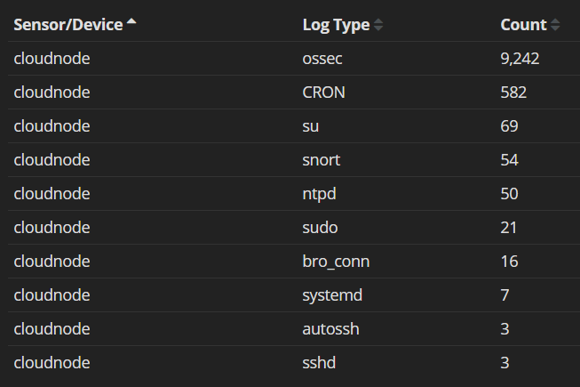
Security Onion: AWS Cloud Node

Slide 58
Security Onion: VPC Mirroring Notes
Suricata (4.1.5+) can natively decapsulate VXLAN
Zeek 3.0.x can now natively decapsulate VXLAN
VPC Mirroring is capable with only Nitro-based instances
https://docs.aws.amazon.com/vpc/latest/mirroring/traffic-mirroring-considerations.html
https://docs.aws.amazon.com/AWSEC2/latest/UserGuide/instance-types.html#ec2-nitro-instances

Slide 59
3CoreSec AutoMirror
Open-source
AWS Lambda function/serverless app
Quickly and easily facilitate cloud NSM
Monitors EC2 instances
If instances created with Mirror=True tag (and if instance is a supported type), their interfaces will be added to a VPC mirror session
Also works for instances that are tagged, then restarted
https://github.com/3CORESec/AWS-AutoMirror

Slide 60
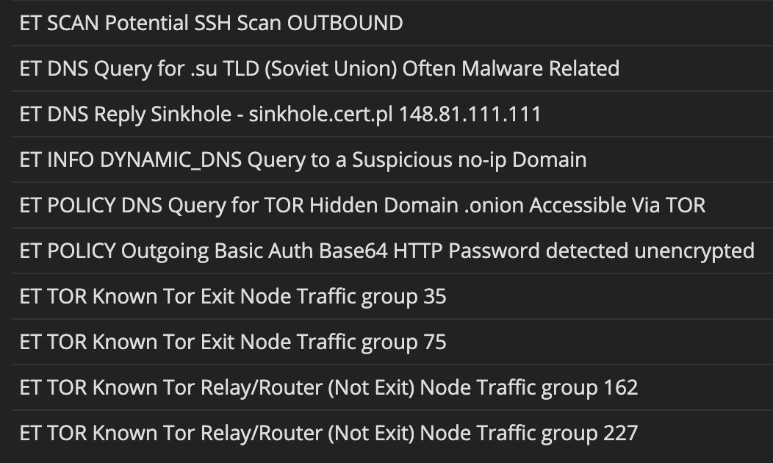
tmNIDS
Open-source
Written by Tiago Faria, 3CoreSec (0xtf)
Test alerting for cloud or on-premises NSM
quickly and easily
https://github.com/0xtf/testmynids.org

Slide 61
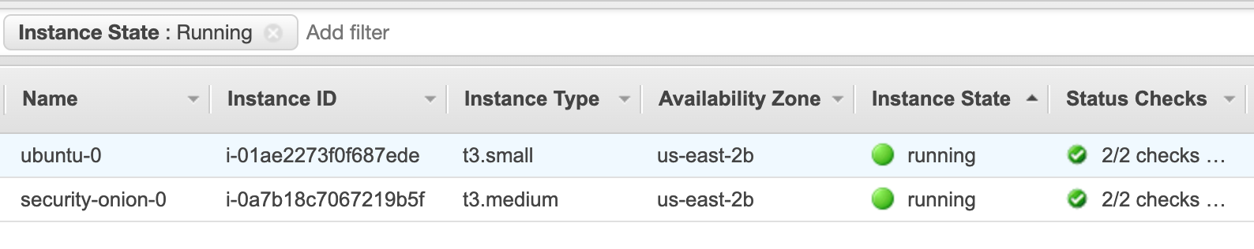
Test AWS VPC Mirroring and 3CS AutoMirror with Security Onion
Follow the instructions below to setup a full-fledged VPC that includes:
Security Onion
Ubuntu/Windows hosts
AutoMirror functionality to automatically mirror the traffic for each of the hosts
https://github.com/Security-Onion-Solutions/securityonion-cloud/tree/master/terraform/aws

Slide 62
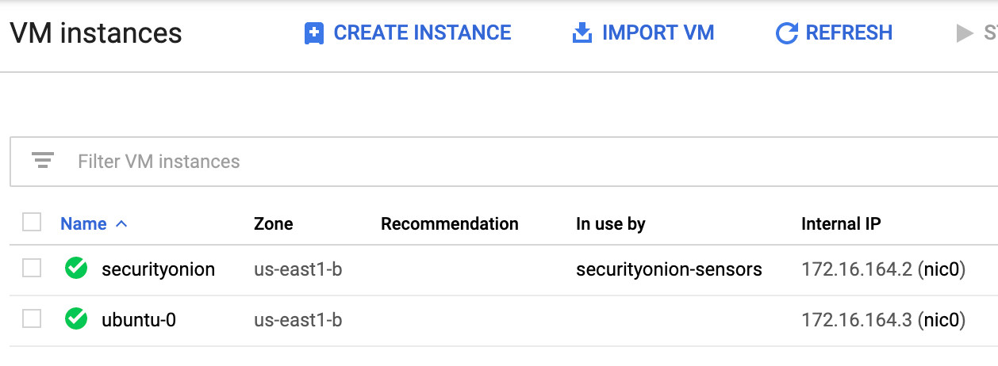
Test GCP Packet Mirroring with Security Onion
https://github.com/Security-Onion-Solutions/securityonion-cloud/tree/master/terraform/gcp

Slide 63
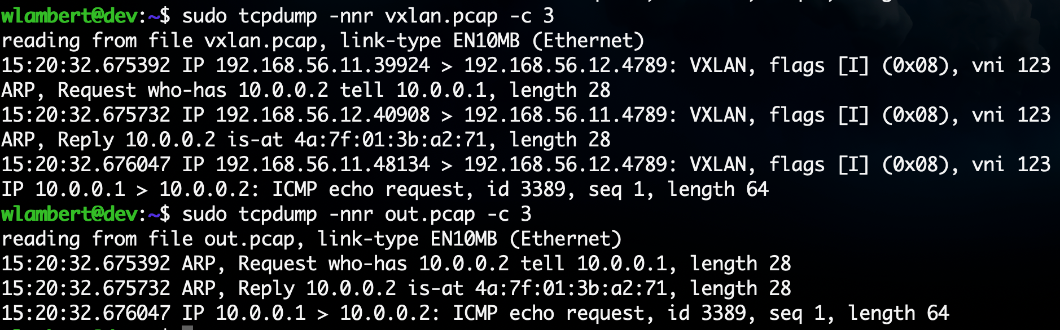
vxlan2pcap
Convert VXLAN-encapsulated PCAP to be readable by tools not supporting VXLAN encapsulation:
./vxlan2pcap vxlan.pcap out.pcap
https://github.com/Security-Onion-Solutions/securityonion-cloud/tree/dev/vxlan2pcap

Slide 64
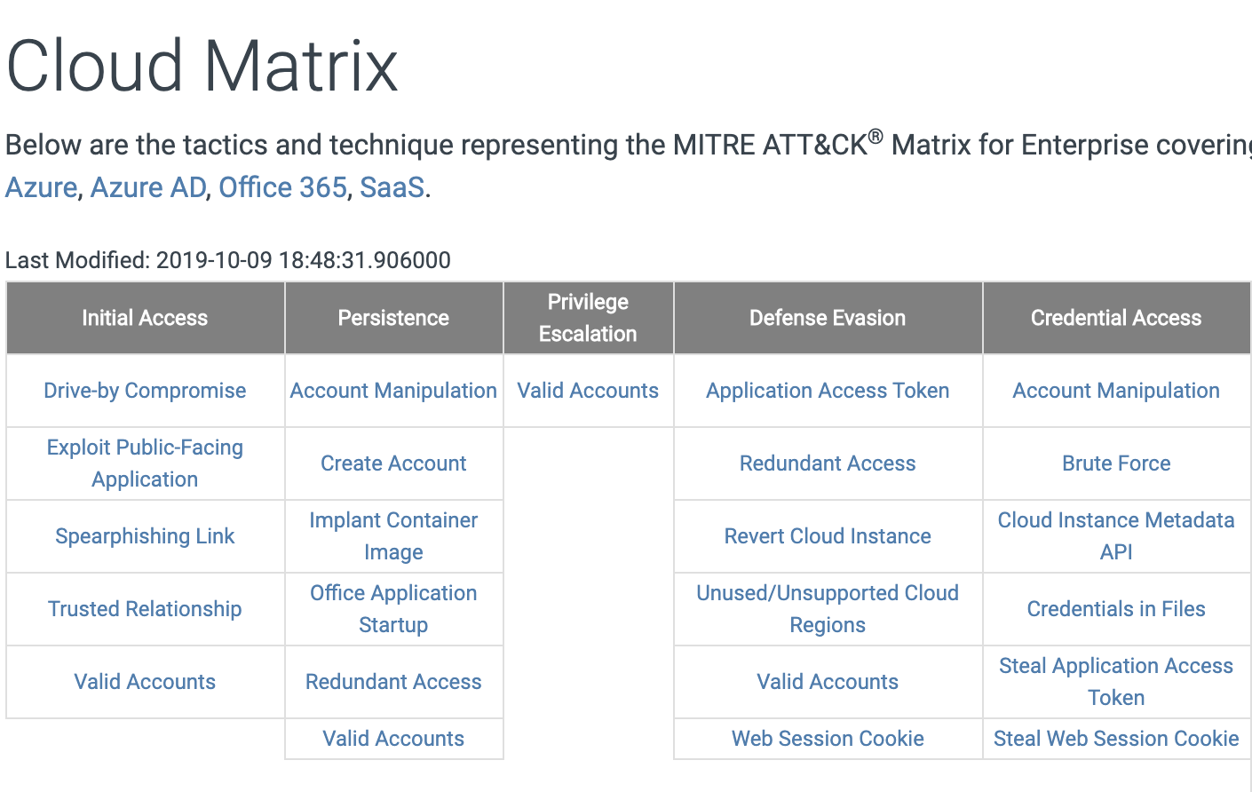
MITRE ATT&CK Cloud Matrix
Adversary tactics and techniques relative to cloud
environments
Create detections for TIDs through the use
of Sigma, then convert to Elastalert rules with Sigmac
Test detections using Atomic Red Team tests
Map successful coverage with ATT&CK Navigator
https://attack.mitre.org/matrices/enterprise/cloud/
https://github.com/redcanaryco/atomic-red-team

Slide 65
Go forth and get your onion on…
@therealwlambert
@securityonion
Download Security Onion
http://securityonion.net
Download the Beta 2 release of Security Onion Hybrid Hunter
Ubuntu 8/Centos 7
Includes Sigma, Playbook, osquery, TheHive, Cortex, and more!
https://github.com/Security-Onion-Solutions/securityonion-saltstack
Documentation:
https://securityonion.readthedocs.io
Professional Services and Support
https://securityonionsolutions.com

